Slide 1
Creating Value
from Technology
24 January 2018
Private and Confidential

Slide 2
Disclaimer
This presentation is confidential and has been issued in connection with the proposed placing of new ordinary shares of Tern Plc. (“the company”). This presentation does not constitute an admission document relating to the Company nor does it constitute or form part of any offer of invitation to purchase or subscribe for, or any solicitation of any such offer to purchase or subscribe for, any securities in the Company not shall this presentation or any part of it, or the fact of its distribution form the basis of or be relied on in connection with, any contract therefore. Recipients of this presentation who are considering acquiring ordinary shares in the placing are reminded that any such purchase or subscription must be made only on the basis of the information contained in the placing letter to be issued on behalf of the Company in due course. No reliance may be placed by any person for any purpose whatsoever on the information or opinions contained in this presentation or on the completeness, accuracy or fairness thereof. All statements (other than statements of historical fact) included within this presentation, including without limitation, the strategies, plans, expectations and objectives of the company, and the markets and economies in which they operate are forward-looking statements. A variety of factors could cause the actual results and expectation to differ materially from the anticipated results or other expectations expressed in the forward-looking statements. These statements are illustrative only and do not amount to any representation that they will be achieved as they involved risks and uncertainties and relate to events and depend upon circumstances, which may or may not occur in the future and there can be no guarantee of future performance. This presentation is being made available only (i) in the United Kingdom to a limited number of prospective investors who are Investment Professionals within the meaning of Articles 19 of the Financial Services and Markets Act 2000 (Financial Promotion) Order 2005 (SI 1529/2005) or (ii) to persons to whom it may otherwise be lawful to make it(all such persons together being referred to as “relevant persons”). Any person who is not a relevant person may not attend this presentation nor rely or act upon matters contained in this presentation. Any person who receives any document forming part of this presentation who is not a relevant person must return it immediately. These presentation materials have not been approved by the Financial Services Authority (“FSA”) as a prospectus for the purposes of section 87A of the Financial Services and Markets Act 2000 and have not been filed with the FSA pursuant to the UK Prospectus Rules. No offer of shares will be made in the UK in circumstances, which would require such a prospectus to be prepared. The distribution of this presentation in certain jurisdictions may be restricted by law and therefore persons into whose possession this presentation comes should inform themselves about and observe any such restrictions. Any such distribution could result in a violation of the law of such jurisdictions. Neither this presentation nor any copy of it maybe taken or transmitted into the United States, Canada, Japan or Australia or distribution to the United States, Canada, Japan or Australia or to any national, citizen, or resident thereof or any corporation, partnership or other entity created organised under the laws thereof. This presentation is being made on the basis that the recipients keep confidential any information contained herein or otherwise made available, whether orally or in writing, in connection with the company. This presentation is confidential and may not be copied, reproduced, further distributed to any person or published, in whole or in part, for any purpose without the consent of the Company. Any person attending this presentation should seek their own independent legal investment and tax advice as they see fit. By receiving this presentation you agree to be bound by the foregoing conditions and limitations. Nothing in this document should be regarded as a profit forecast. In particular, statements referring to expected earnings per share (“EPS”) enhancement should not be interpreted to mean that the consolidated EPS of the Company will necessarily be greater than or equal to its historical earnings per share.
This presentation reflects certain opinion of the directors of the Company at the date of the presentation.

Slide 3
Vision
“to become the leading investment company specialising in IoT by unlocking opportunities others haven’t seen or thought possible, to deliver significant returns for shareholders"
Notes:
Key messages: We look for the uncut diamonds that can be transformed in value

Slide 4
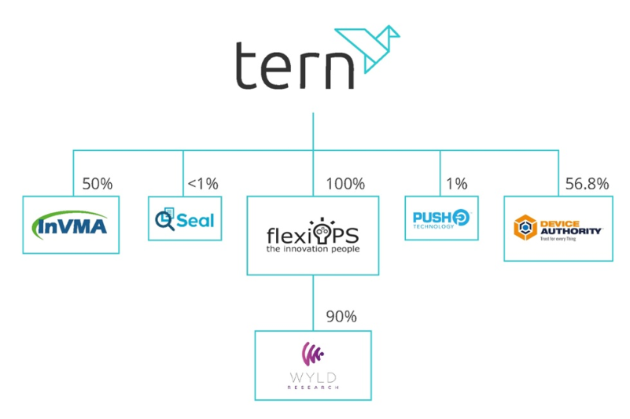
Tern at a Glance
AIM listed investment company created in 2013
Investment Focus: The Internet of Things (IoT)
Five portfolio companies including Device Authority and InVMA holdings which are making strong headway in the growing IoT security space
Emphasis on active participation in portfolio companies
Initial funding from Founders followed by placements totals £5.6m
Significant shareholders
Al Sisto (CEO) | 5.5%
Bruce Leith (Business Development Director) | 5.1%
Canaccord Genuity Group Inc | 4.3%
City Financial Equity Fund | 4.1%
Michael Clark | 3.6%
John Mahtani | 3.0%

Slide 5
Management Team
Executive Directors have 100+years combined board experience sold 27 companies and been involved in over 100 transactions in the IT sector
Al Sisto
CEO
Ian Richie
Chairman
Bruce Leith
Business Dev Director
Sarah Payne
Finance Director
Alan Howarth
Non-Exec Director
Venture investor in 8 tech companies. Sold Hifn to Exar Corp for $63M. Venture Partner Nauta Capital, Former CEO Hifn, CEO Phoenix Technologies, COO RSA Data Security
Non-executive Chairman of Iomart plc, founder od OWL which pioneered hypertext application development sold to Panasonic in 1989, has been involved in over 40 start-up high-tech businesses
IT sales management for entire career, IBM, Dataworks, London Bridge, Software, Codestream, Misys
Qualified with EY as a chartered accountant. Head of financial planning at BBC. For past 7 years has been finance director for high tech companies.
Management consultant with EY. Since 2003 has been an exec and non exec director of many quoted and unquoted IT and healthcare companies

Slide 6
Progression in 2017
Strengthened Board
Improved deal pipeline via new investments
Solid progress made by DA – blue-chip partnerships and contracts
Working capital secured to enable progress

Slide 7
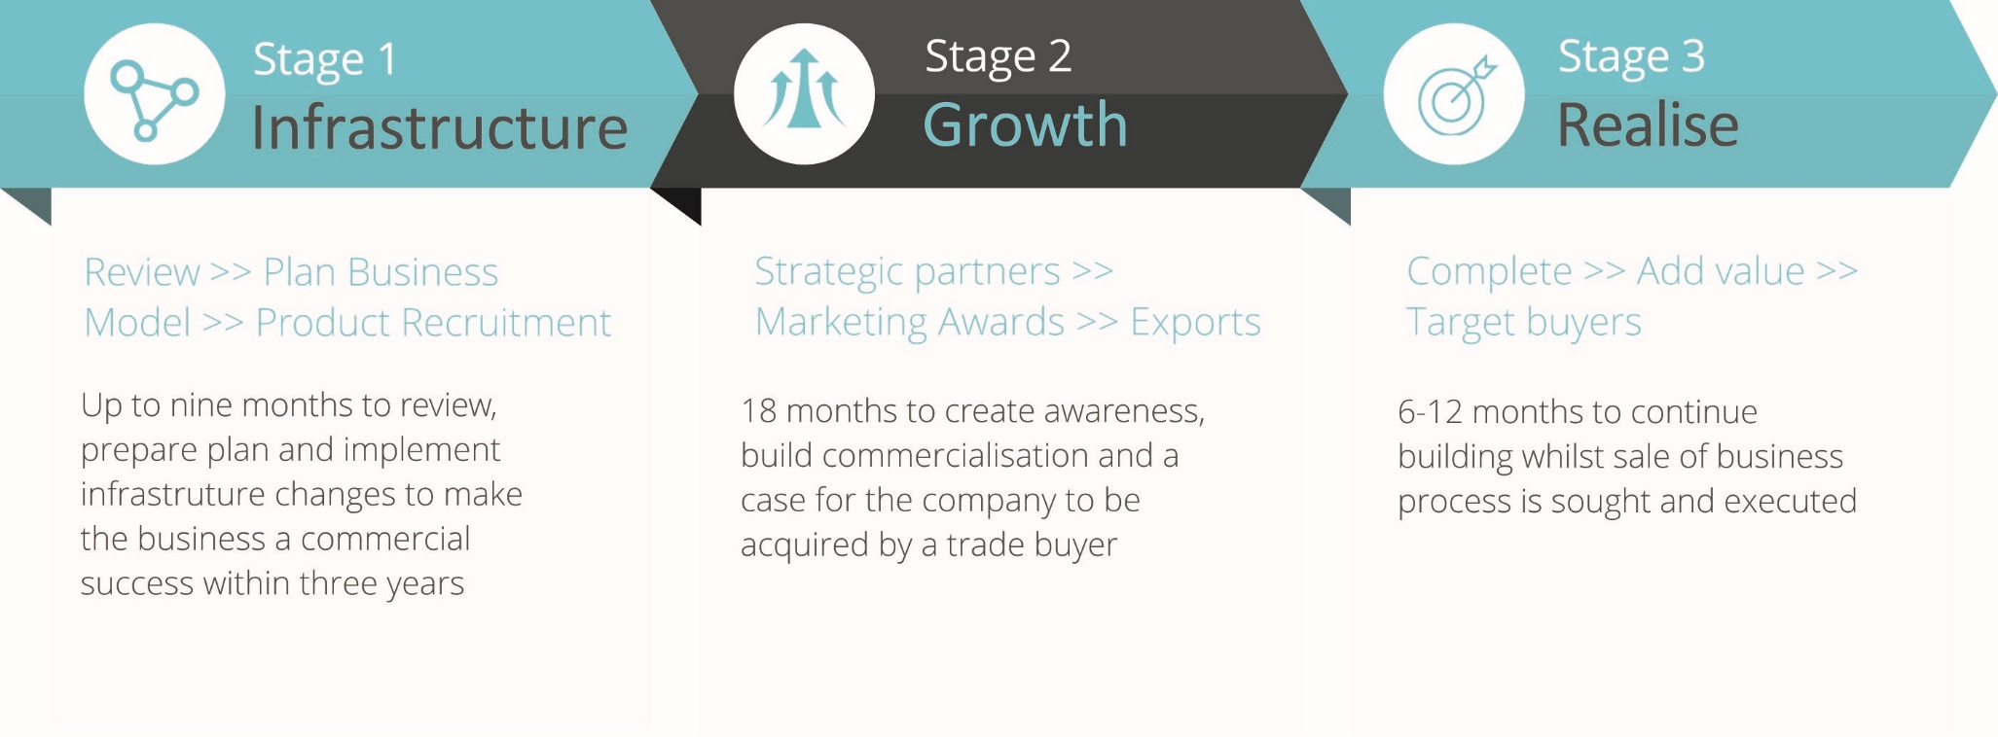
Our Process to Create Value
Notes:
A key message - I think this slide provides a nice opportunity to educate shareholders that while you are hands-on (perhaps we should say active?!) you have an investment company relationship with your portfolio companies AGREE
Key Message: We set off right from the start to apply a methodology to our portfolio to unlock value and establish market presence and relevance with a goal of an exit with an IRR of significance

Slide 8
DA: Journey Since 2014
Closed acquisition in September 2014, total capital outlay of £300k
Sisto appointed as new Chairman and new SAAS business model established
Experienced team appointed: Darron Antill as CEO alongside sales director and US sales VP
Current company created in April 2016 as result of Cryptosoft acquiring Device Authority Inc.
Gained US Venture Partner Alsop Louie (ALP)
Funding: Raised $5m from Tern PLC (57%) and Alsop Louie Partners (16%)
Product: KeyScaler Security Platform completed Q4 2016 provides IoT applications security at IoT scale
Notes:
Key Message: Do not read the slide, but point out that an acquisition that was received with little notice, we have transformed the company into a well regonized player in the IoT security space and a significant component of the NAS of Tern

Slide 9
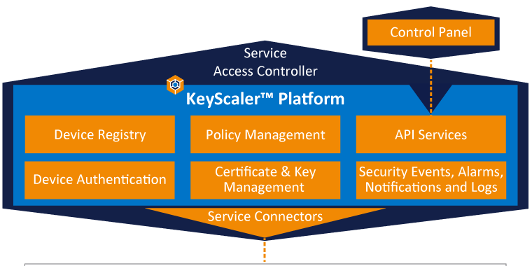
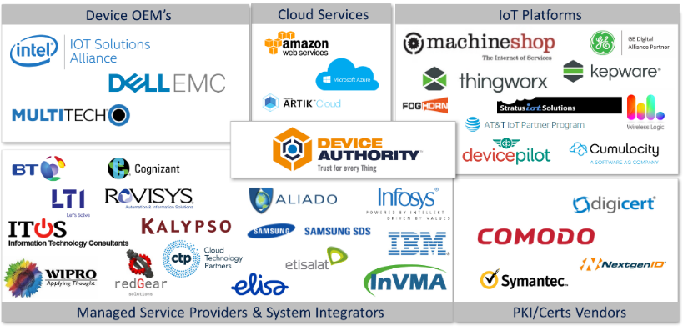
Device Authority Today
A well-recognised, award-winning international business delivering innovations in IoT security with bases in the UK and the USA.
TechRadar™: Internet Of Things Security, Q1 2017
A Mix of New and Existing Technologies Help Secure IoT Deployments
Cool Vendor - 2016
The UK’s Most Innovative Small Cyber Security Company
IMPACT REPORT – May 2nd 2017
Device Authority takes a dynamic approach to IAM for IoT devices
On the Radar: Device Authority secures IoT with scalability and automation
6
Notes:
Key Messages:
Device Authority is addressing existing big problems:
1. Weak identities (passwords or other credentials)
2. GDPR and ePrivacy Regulations
3. We know that proven PKI technology can solve identity, authentication, integrity and privacy, for some on premise situations, however the cost and complexity are well known, and delivering for cloud-based services and at scale required for IoT adds new challenges.
Device Authority is active member of IoT security bodies driving best practises and awareness, e.g. IoT SF, OTA and FUSE.
Industry recognition from key IoT analysts.
DA has been building out our Ecosystem of partners; all play an important role in the IoT landscape in building IoT solutions with security embedded in as part of a solution OR by adding security as a service to an existing installed base of devices as well as build into future product offerings. Partnerships are very important and we are active with Intel IoT and the Secure Device On-boarding program recently launched, AWS IoT Marketplace, Dell IoT program, and PTC Thingworx marketplace.

Slide 10
DA’s Recent Progress
DA’s partner network spans IoT platform providers, Certificate Authorities, System Integrators, Device OEMs and Gateways
Oct. 2017: Integration of KeyScaler(TM) with Intel® Secure Device onboard
July 2017: KeyScaler 5.5 released inc. an Amazon IoT PKI
Sept. 2017: Signs a 5-year agreement with MultiTech
Sept. 2017: Signs a 3-year global agreement to power Comodo CA's IoT security service
Oct 2017: New partnership with Super Micro Computer, Inc
Jan 2018: Reseller agreement signed with Thales to deliver trust for IoT

Slide 11
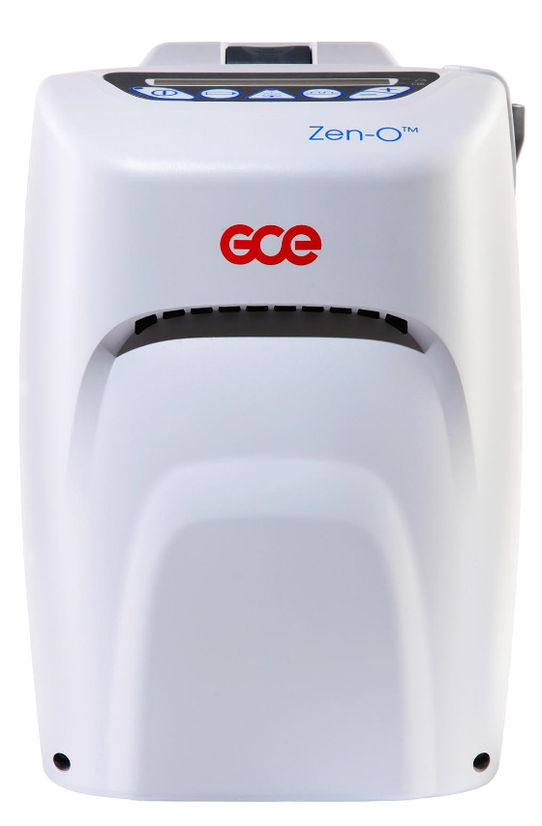
New Investment: InVMA
Established and growing player in market for IoT enablement – building applications on leading PTC/ThingWorx platform for industrial and medical verticals
AssetMinder™, an automated sensor data collection application for resource monitoring, predictive maintenance and source data collection built on Thingworx Platform application
Created by InVMA and being sold direct and via resellers
Strong technical team with product development and implementation skills
Go To Market strategy, direct and via partners. Strategic partner of leading IoT player PTC/Thingworx
Management has experience of building a related industrial control systems business InControl Systems Ltd
Flowrate = 5
Mode = 2
Location = 42.3601, 71.0589 °
Flowrate = yIHBhc3Npb24
Mode = dDSLsd£dUWFSdY
Location = WdsOI7&%sIuYs

Slide 12
InVMA: 2017 Highlights
£1 million bookings confirmed for 2017
Since Tern investment, InVMA has secured new customers in OEM, Oil and Gas, Asset Rental and Manufacturing markets
Key contract wins: UK/International Airport, Howden Process Compressors, MSE Hiller, MEMS, GCE
Team expansion underway: Two experienced sales managers now in place
In September 2017, InVMA launched its new product, AssetMinder™, which delivers real-time insights from remote and unmanned equipment and integrates Device Authority's KeyScaler
Secured Gitex 2018 as an Etisalat IoT Partner targeting the UAE & GCC countries
AssetMinder™ is deployed in Etisalat’s Innovation Centre in the UAE

Slide 13
flexiOPS at a Glance
A profitable UK company developing a portfolio of EU and UK funded research and development projects
Spin-off from Flexiant
100% owned by Tern with Tern directors serving as Chairman and as director
Mission to provide development resources, research grant work and funding for Tern and its portfolio companies
Original work focused on Horizon 2020 grants, now expanded to also include Innovate UK grants and other government funding sources
Vehicle used to acquire 90% of Wyld Research, a company providing mesh networking
Notes:
Key Message: This investment is part of the Phoenix of our 1% investment in Flexiant and provides our portfolio companies with access to government grant funding and collaborative R&D resourcing.

Slide 14
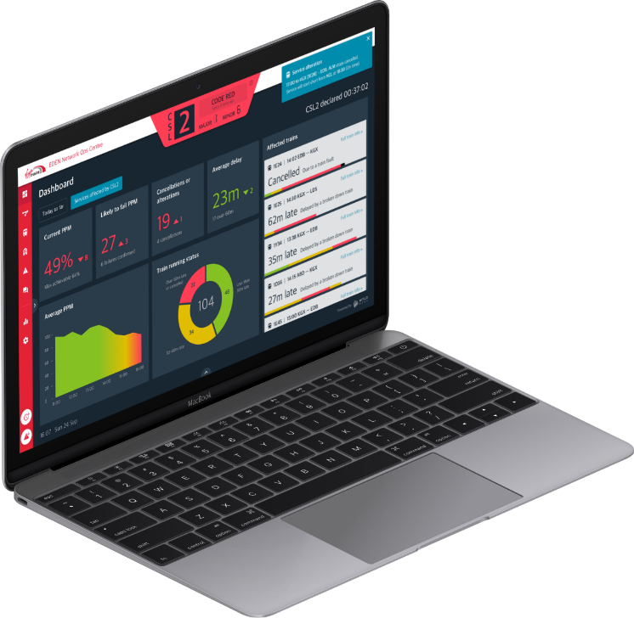
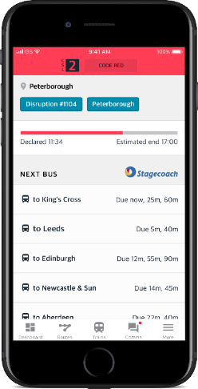
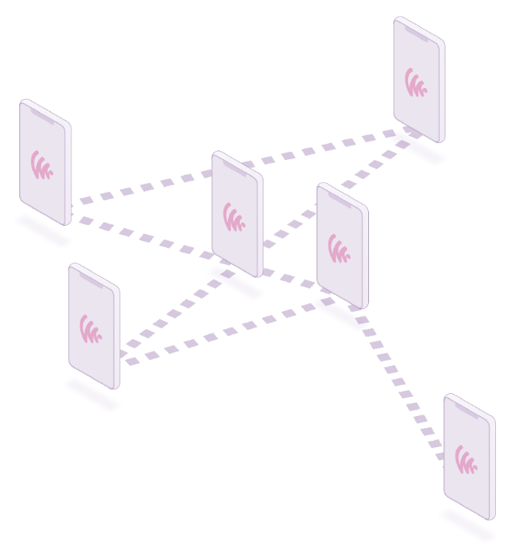
New Investment: Wyld Technologies
Tern purchased the assets of Wyld Technologies, a mesh networking company, in Sept 2017
Wyld Mesh platform is a hybrid mobile ad hoc personal networks combined with OTT Internet streaming, a resilient network topology adding an entirely new dimension to push notifications, streaming data and media
The predecessor company Wyld Research worked on programs with London Underground, developing next-generation mobile & emergency communications prototypes
Management has experience developing innovative applications and has built a strong and diverse technical product development team since the acquisition
14
Notes:
Far too many words…
Key Message: Wyld is an investment of important strategic value in our IoT investment space. IoT sensors and gateways generally operate in traditionally network unfriendly environments, Oil platforms, transport systems, hospital settings, energy production, for example. With an initial focus on transportation and industry recognition of their Software Defined Mesh Network, (SDMN) we feel they will be a important player in the movement of data from and between IoT devices.

Slide 15
Tern’s Current Situation
Focused on improving shareholder communications via website and regulatory and non-regulatory announcements
Strategy
Portfolio Development
Progress has been made, but not without issues and concerns
CULN
DA funding and performance
Director changes
Communications
Early communications based on forecasts not facts
A number of original assumptions that were made are no longer valid
Tern cannot own 100% of a company and build a portfolio of companies
Tern needs to syndicate positions and capital risk
Clear expectations were not set on what it takes to build a global tech business
Messaging policy that did not completely take into consideration the various vehicles available

Slide 16
Creating value from technology
Tern is building a software group and expanding its team
Focused on fast-growing IoT market
Continued progress at DA
New developments at InVMA
Strong prospects for Wyld
Unique access to Silicon Valley resources and beyond to our investors and portfolio companies
Notes:
Key Message: We’ve help create Device Authority and we believe we can repeat with our other investments. We are in the fastest growing high tech segments, IoT and we have demonstrated our ability to syndicate with Silicon Valley companies and investors.
Now to your questions…

Slide 17
Thank you!
20 Eastbourne Terrace
London, W2 6LG
e: info@ternplc.com
t: 020 3807 0222
ternplc.com

